Slide 1
Chemotaxis: Bacterial Motors and Random Walks

Slide 2
Chemotaxis: Bacterial Motors and Random Walks
A.K.A. Big words to impress your friends
A.K.A. A lot of things about how bacteria move around

Slide 3
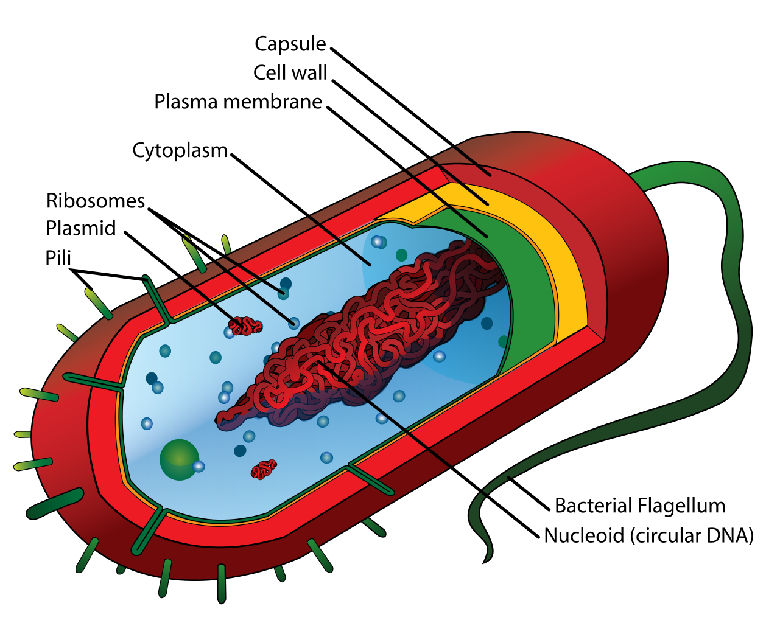
What are bacteria? (why do they need motors?)
Let’s Talk About Bacteria
Notes:
MicroOrganisms, what do you know about them? you may know diseases, no nucleus, cell wall, some of them are gram + or – based on structure of their cell membrane… we don’t care about a lot of those things don’t worry. DO care about: HOW THEY MOVE!!! Tiny (a few micro meters) , yet they are able to travel around and live their lives and if you look at them under a microsope, they really seem to be able to achieve their simple goals and survive in their environment. WHICH IS WEIRD! (I like bacteria a lot)

Slide 4
Why does a bacterium need to move?
Let’s Talk About Bacteria
Notes:
Brainstorm - > 2 lists: attractants and repellants

Slide 5
Chemical concentration gradients
Let’s Talk About Bacteria
Notes:
QUESTION FOR THE MASSES: what is a gradient?
->What is a concentration gradient?
-> SO a chemical concentration gradient is a gradual difference in concentration (amount) of some chemical over some amount of space
WHY DO WE CARE?
Bacteria love concentration gradients!
When they want to go towards an attractant or away from repellant, they are really moving from high to low or low to high along a chemical concentration gradient

Slide 6
Chemo + taxis
Chemotaxis: what is it?
Notes:
Board work

Slide 7
Chemo + taxis
Chemotaxis: what is it?
Chemicals + moving
Moving in response to chemicals!
Notes:
So actually we already know what chemo taxis is! Just a word for bacteria moving around by responding to chemicals: chemical gradients from before

Slide 8
Chemo + taxis
Chemotaxis: what is it?
Chemicals + moving
Moving in response to chemicals!
Notes:
So actually we already know what chemo taxis is! Just a word for bacteria moving around by responding to chemicals: chemical gradients from before

Slide 9
Anatomy of a bacterium
Let’s Talk About Bacteria
Notes:
FLAGELLA, RECEPTORS.
Let's talk about bacteria: receptors for chemicals to "count" the concentration (what they actually do is start a chain reaction inside the cell, that leads to a specific amount of proteins changing shape/makeup).
Let's talk more about bacteria: Anatomy of a bacterium. Focus on flagella.

Slide 10
But how do they move?
Let’s Talk About Bacteria
Notes:
They swim.
FLAGELLA
How do flagella move?
HINT: it’s one of our buzzwords for this class……

Slide 11
But how do they move?
Let’s Talk About Bacteria
MOTORS!
Notes:
They swim.
FLAGELLA
Put BACTERIAL MOTORS on board

Slide 12
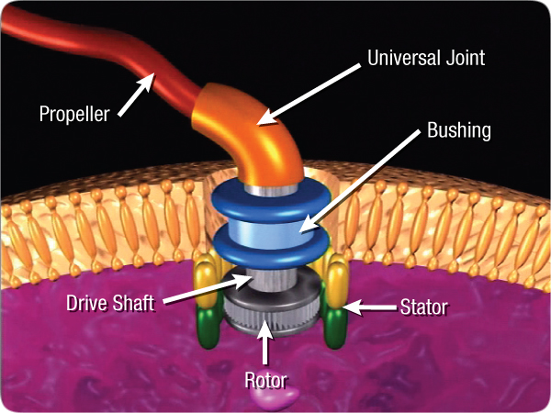
Let’s Talk About Bacteria
MOTORS!
Notes:
They swim.
FLAGELLA

Slide 13
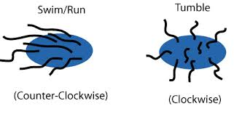
2 modes of swimming
Let’s Talk About Bacteria
Notes:
What happens? (draw map of where I go)

Slide 14
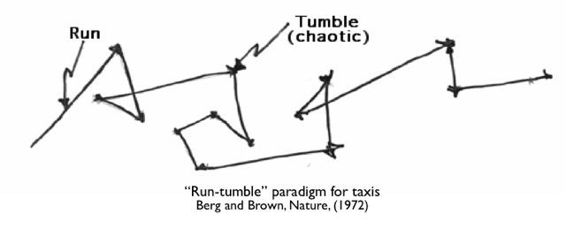
2 modes of swimming
Let’s Talk About Bacteria
Notes:
Like a roomba or a wind up toy that bumps into walls

Slide 15
Recap and questions?
Let’s Talk About Bacteria
Notes:
Like a roomba or a wind up toy that bumps into walls

Slide 16
Vehicle? Destination? How to get from point A to point B?
Google Maps vs. Bacteria
Notes:
Recap: so far we know why bacteria want to move (attractants and repellants), where they want to go (up or down a concentration gradient), and what makes them go (flagella mounted on motors)

Slide 17
Vehicle: Bacteria + motor Destination: Attractant How to get from point A to point B? ??????
Google Maps vs. Bacteria
Notes:
Reminder why this is a hard question: imagine trying to get from point A to point B but the only things you're allowed to do are:
Run at top speed in whatever direction you're already facing
Spin around and flail wildly in place for a little bit until you're facing in a new (random) direction
This could go horribly, terribly wrong if I pick the wrong strategy
If I decide ahead of time that I'm going to alternate running for 5 seconds, spinning for 5 seconds, what happens? I'm never going to get anywhere in particular.

Slide 18
Vehicle: Bacteria + motor Destination: Attractant How to get from point A to point B? Random walk!
Google Maps vs. Bacteria
Notes:
Reminder why this is a hard question: imagine trying to get from point A to point B but the only things you're allowed to do are:
Run at top speed in whatever direction you're already facing
Spin around and flail wildly in place for a little bit until you're facing in a new (random) direction
This could go horribly, terribly wrong if I pick the wrong strategy
If I decide ahead of time that I'm going to alternate running for 5 seconds, spinning for 5 seconds, what happens? I'm never going to get anywhere in particular.

Slide 19
What’s a random walk?
Random walks
for Fun and Profit
Notes:
a path that consists of a succession of random steps.
PUT ON BOARD

Slide 20
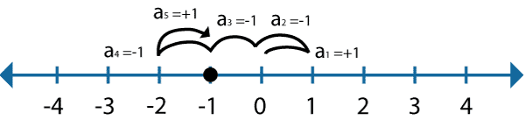
The simplest random walk
Random walks
for Fun and Profit
Notes:
a path that consists of a succession of random steps.
PUT ON BOARD
If time: act out a random walk
PAUSE FOR QUESTIONS

Slide 21

Pure random walk
Bacteria + Random walks = success?
Notes:
a path that consists of a succession of random steps.
PUT ON BOARD
If time: act out a random walk
PAUSE FOR QUESTIONS

Slide 22
Pure random walk
Bacteria + Random walks = success?
Biased
Notes:
Bias means you secretly have a strategy.
So what we want to create is mathematically called a biased random walk
(Board) biased because we are biased towards moving towards the food, rather than liking all directions equally.

Slide 23
Pure random walk
Bacteria + Random walks = success?
Biased
You are a bacterium.
Come up with a strategy to get yourself some delicious glucose.
Things you can do: run, tumble, decide how long to do either of those, "sniff” to measure the chemical gradient
Notes:
Goal answer: run for longer if you're sensing more food than before.
Wait, does this mean that bacteria can sense change over time?
Due to a complicated system of receptors and chain reactions that can increase or decrease their sensitivity over time, yes! It's crazy complicated but the main idea is that you get used to whatever concentration you're in, and only care about relative increase or decrease compared to what you're used to right now.

Slide 24
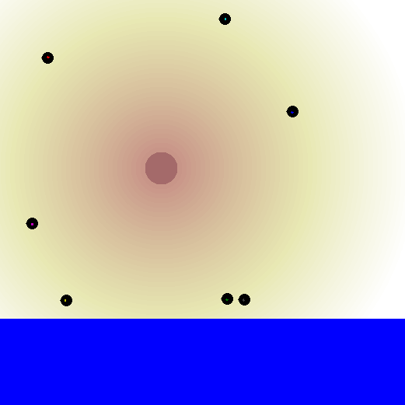
Pure random walk
Bacteria + Random walks = success?
Biased
Notes:
Strategy in motion!

Slide 25
Pure random walk
Recap Recap Recap
Chemo + taxis
MOTORS! (flagella run and tumble)
Biased
Notes:
Strategy in motion!

Slide 26
Pure random walk
Recap Recap Recap
Bacteria sense change over time
Chemo + taxis
MOTORS! (flagella run and tumble)
Biased
Notes:
Strategy in motion!

Slide 27
Recap Recap Recap
Bacteria are awesome
Random walks are stupid and so are bacteria. But probability makes them work ☺
Notes:
Strategy in motion!

Slide 28

Questions?
Notes:
Strategy in motion!

